Slide 1
T1A3 Terminal App
Ashlie Gray

Slide 2
T.P.R Tracker (Temperature, pulse & respiratory)
App designed to streamline the process of rounds in a vet hospital
Allows user track the vital signs on inpatients

Slide 3
Main Features
Login/create user profiles
Find /create patient profiles
Add log of vital sign values to patient.
View the patient log that they or others have which is identified and (hopefully)time stamped.
Menu system, opening, main, patient and help.

Slide 4
Code
Classes – User and Patient
Methods – add log, view log, title screen
Code heavily reliant on user input. Functions by user input that loops through program
Csv files used to store databases for users and patients
Csv file used to log input and present to screen in file
Gems – TTY Prompt, TTY Table, colorize

Slide 5
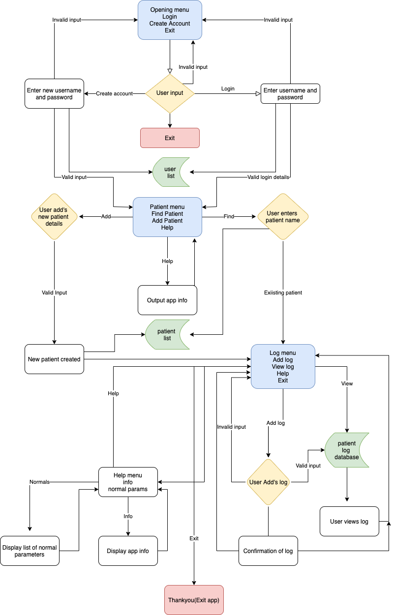
Development Process
Started with the idea, determined the ‘parts’ I would need then how it would work with the control flow diagram.
Challenges – putting the overall puzzle that was my code, together.
Ethical issues- Ideally higher level of authentication needed. Ability to delete
Favourite parts - Gems and getting it to work

Slide 6
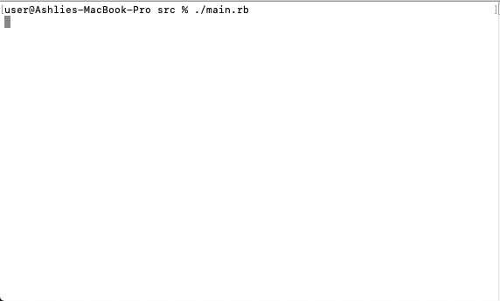
Preview

Slide 7

Thank you for listening!

